Slide 1

Blind-Face
(Face Expression Identification Using Image Processing)
PRESENTED BY :
Vikaskumar Darji (160303108018)
Rishi Joshi (160303108042)
Krupali Kumbhani (160303108052)
UNDER GUIDANCE OF :
Prof. Awadhesh Dixit
ASSISTANT PROFESSOR
(IT DEPARTMENT)

Slide 2
OUTLINE
Introduction
Motivation
Aim & Objectives
Application/s
Literature Survey
Methodology
Existing Workflow
Proposed Workflow
Conclusion
References

Slide 3
INTRODUCTION

Slide 4
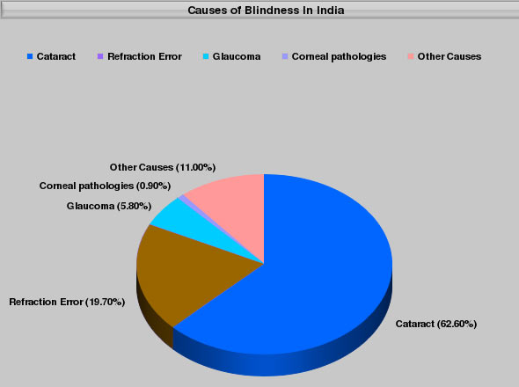
Blind-Face
Fig 1 Blindness ratio
Face expression recognition plays a crucial role in the area of blind person interaction.

Slide 5
Continues…
humans recognize facial expressions virtually without any effort,reliable but expression recognition by blind person is still a challenge.
Automatic face expression analysis and recognition is a complex task because faces vary from one individual to another quite considerably due to different age and image quality.
Even if recognition is done in a constraint of faces specific to some culture, several factors like presence of enviroment,skin colour variation etc. So it plays an important role in many research fields such as psychology, social interaction, human-computer interaction, security, mental state identification, lie detection, people identification, and nonverbal communication in daily life.

Slide 6
MOTIVATION

Slide 7
MOTIVATION
In today’s World, The blindness is a one of the most serious concern. mainly for a blind person can get injured by any object ,So this is a serious problem in day to day life.
So we thought about this and coming up with the Blind Assistance which help the blind person to identify object and notify to blind person by using Headphones. So they can easy interact with object and get not injured by using Blind-Face.
We can decide to help Blind Person Using Our device. They can Take care of them self by avoiding some obstacle and Easy communication.

Slide 8
AIM & OBJECTIVES

Slide 9
AIM & OBJECTIVES
Our aim here is to help blind person that use our device to identify the person and using this device they know the expression of the person and also we try to help they can't injured by obstacles and live happy in a daily life using Assistance Device.
Objectives following:
To provide a user friendly environment for blind person
To provide face identification
To detect face emotion of a person
To provide a detection of objects
To provide Assistance System.(Future Work)

Slide 10
Application
Blind face can be use as:
For Blind Assistance System
In Facial Gesture Implementation
In Locking System for home Automation security
For Human-To-Machine communication
To Identify Mental Health System

Slide 11
LITERATURE SURVEY

Slide 12
PAPER 1:
Local Gaussian Difference Extrema Pattern: A New Feature Extractor for Face Recognition
Publication and Year | Author name | Approach (Methodology) | Advantages | Limitations
International Conference on Image Information Processing (ICIIP) 2017 | K. M. Biradar, Varun Kesana, K. B. Rakhonde, Ankita Sahu, A. B. Gonde, S. Murala | Pre-processing using Block based local binary pattern (BLBP),feature extraction using directional local extrema pattern (DLEP), k-nearest neighbors (KNN) classifier, face recognition | Able to add prior knowledge and specifications about the shape of the model by selecting different kernel functions | Kernel Selection

Slide 13
PAPER 2:
A Fast and Accurate System for Face Detection, Identiﬁcation, and Veriﬁcation
Publication and Year | Author name | Approach (Methodology) | Advantages | Limitations
JOURNAL OF LATEX CLASS FILES,IEEE 2015 | Rajeev Ranjan, Ankan Bansal, Jingxiao Zheng, Hongyu Xu, Joshua Gleason, Boyu Lu, Anirudh Nanduri, Jun-Cheng Chen, Carlos D. Castillo, Rama Chellappa | Face detection using Deep Pyramid Single Shot Face Detector , Pre-processing using Anchor pyramid with ﬁxed aspect-ratio | Fast and accurate method Deep Pyramid Single shot Face detector | Object size should not be less than 5% of image

Slide 14
PAPER 3:
Robust Face Detection Using Hybrid Skin Color Matching under Different Illuminations
Publication and Year | Author name | Approach (Methodology) | Advantages | Limitations
International Conference on Electrical, Computer and Communication Engineering (ECCE), IEEE 2019 | Asif Anjum Akash, A. H. Akhand, N. Siddique | Feature extraction using colour detection using RGB and skin detection Haar feature based face detection (HAAF) | Object can easily identify because of colors | Some objects have same color that object cannot be identify

Slide 15
PAPER 4:
Face Detection with the Faster R-CNN
Publication and Year | Author name | Approach (Methodology) | Advantages | Limitations
International Conference on Automatic Face & Gesture Recognition IEEE-2017 | Huaizu Jiang, Erik Learned Miller | Face detection using Faster R-CNN | Accurate, Any deep architecture can immediately be “plugged in” | Some loss of accuracy due to lower recall, poor localization

Slide 16
PAPER 5:
DETECTION OF ACCURATE FACIAL DETECTION USING HYBRID DEEP CONVOLUTIONAL RECURRENT NEURAL NETWORK
Publication and Year | Author name | Approach (Methodology) | Advantages | Limitations
CTACT journal on soft computing special issue on artificial intelligence and deep learninging 2017 | M. Sivaram, V. Porkodi, Amin Salih Mohammed V. Manikandan | Hybrid DCRNN: CNN+RNN (recurrent neural network) | RNN work well if we are dealing with huge amount of data | RNN require enough training data

Slide 17
PAPER 06:
A Static Hand Gesture and Face Recognition System For Blind People
Publication and Year | Author name | Approach (Methodology) | Advantages | Limitations
International Conference on Signal Processing and Integrated Networks (SPIN) 2019 | ^{Saransh Sharma,} ^{Samyak Jain,} ^{Khushboo} | Hand Gesture detection: Split hand Skin Colour System in RGB to YCbCr, Egde detection Contour Detection, Convex hull Used for extract fingers point, Heron's formula used recognize hand point Facial Recognition: Face Detection using Haar Cascade Classifier and Face Identification using LBP(Linear binary pattern) | High discriminative power, Computational simplify is easy to others. It will give high accuracy on low resolution image because of LBP method is used. | The size of the features increases exponentially with the number of neighbors which leads to an increase of computational complexity in terms of time and space
BlindFace

Slide 18
PAPER 07:
Facial Expression Recognition in Image Sequences Using 1D Transform and Gabor Wavelet Transform
Publication and Year | Author name | Approach (Methodology) | Advantages | Limitations
International Conference on Applied and Engineering Mathematics, 2018 | Maria Mahmood , Ahmad Jalal, Hawke A. Evans | Feature extration using Gabor wavelet transform and Radon transforms along with Robust Classifier Self-Organizing Map and nueral network for measure six expression | The data is easily interpreted and understood. Neural networks can be trained with any number of inputs and layers. | Slow training, hard to train against slowly evolving data It is computationally very expensive and time consuming to train with High Processor CPU.

Slide 19
PAPER 08:
Enhancing Emotion Detection Using Metric Learning Approach
Publication and Year | Author name | Approach (Methodology) | Advantages | Limitations
Innovations in Computer Science and Engineering 2018 | Ashutosh Vaish, Sagar Gupta, Neeru Rathee | Feature Extraction using Local binary pattern Classifier used SVM | SVM are very good when we have no idea on the data | Choosing a “good” kernel function is not easy

Slide 20
PAPER 09: A Comparative Analysis on various Face Recognition Techniques
Publication and Year | Author name | Approach (Methodology) | Advantages | Limitations
IEEE / International Conference on Intelligent Computing and Control Systems ICICCS 2017 | Dr. Naveen Kumar Gondhi, Er. Navleen Kour | neural networks , SVM | Storing information on the entire network, Ability to work with incomplete knowdge. | Need a larger dataset, Training time is large

Slide 21
PAPER 10: SIFRS: Spoof Invariant Facial Recognition System
Publication and Year | Author name | Approach (Methodology) | Advantages | Limitations
IEEE /9th ICCCNT 2018 | Aditya Dixit VR Satpute | -facial detection -Tracking -SVM/ | -Small change to the data does not greatly affected. -Stable | -Algorithm complexity is high. -memory requirement is high.

Slide 22
PAPER 11: Overview of Biometric and Facial Recognition Techniques
Publication and Year | Author name | Approach (Methodology) | Advantages | Limitations
IOSR Journal of Computer Engineering (IOSR-JCE) | Omoyiola, Bayo Olushola | Biometric Systems -Fingerprint recognition -Retina scanning -Iris scanning Facial Recognition Facial Detection | -More accurate -No need to thousands comparision | Biomertics are permanetly associated with user. Not replaced.

Slide 23
PAPER 12: Mobile CMOS Image Sensor Test System through Image Processing Technique
Publication and Year | Author name | Approach (Methodology) | Advantages | Limitations
International Journal of Trend in Scientific Research and Development (IJTSRD), 2019 | Rajesh Kumar, Gargi Kalia | CMOS (Complementary metal oxide semiconductor) sensor. | CMOS have their own amplifier, data transfer rate is fast. | there is a limit on the minimum pixel size because of the greater sensitivity

Slide 24
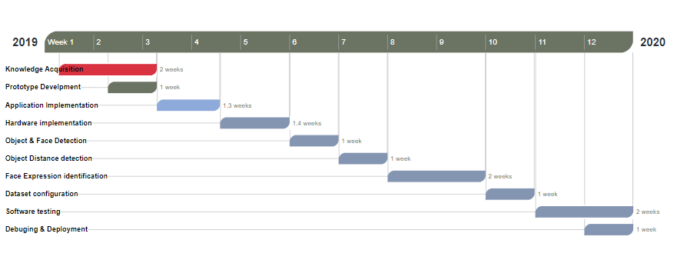
Grant Chart

Slide 25
Methodology
Here we can describe methods that will use in Project:
Haar Cascade Classifier:
Haar Cascade classifier is based on the Haar Wavelet technique to analyse pixels in the image into squares by function training a classifier which identifies a face.
Using this We can find Face Detection and Finding some Expression like Smile, Angry, etc.
LBPH Classifier:
Local Binary Pattern Histogram(LBPH) is a simple yet very efficient texture operator which labels the pixels of an image by thresholding the neighborhood of each pixel and considers the result as a binary number.
Using this we can find Face recognition of a person.

Slide 26
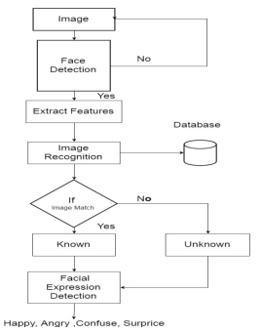
Existing Workflow

Slide 27
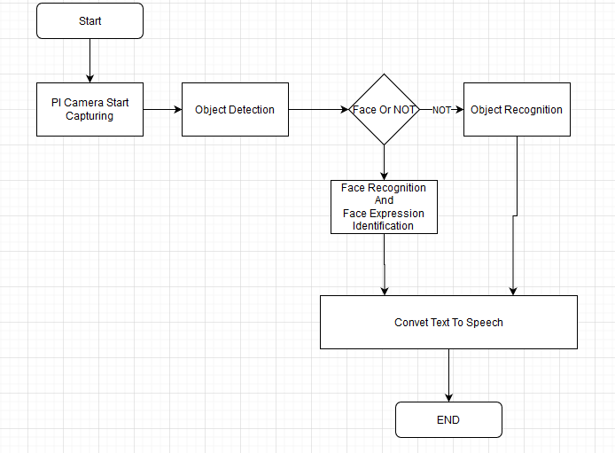
Proposed Workflow

Slide 28
Continue…
After doing study on various technology ,we have tried to implement a system using PI Camera, Raspberry PI , Haar cascades feature extraction, LBP classifier, Bluetooth/Headphone.
The PI Camera Used For Capture Images and using Real-Time We can find Face Expression using Haar cascades Classifier.
after image is taken from Pi Camera or Start Video Stream Using OPENCV.
The Face detection is applied that will predict the face or object. If it is face, then after going for first Face Recognition using LBP Classifier and After find face expression using Haar-cascade classifier method.
if Person name and expression identify in text ,convert text to audio using python library.
Now Audio can be audible by Using Headphones.

Slide 29
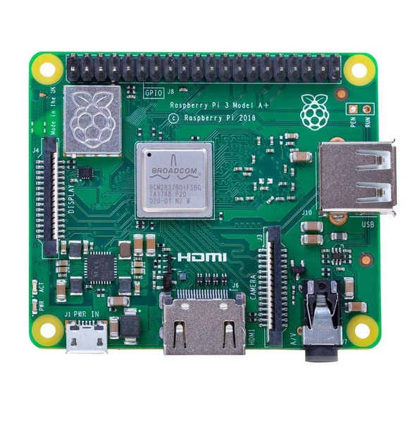
IMPLEMENTATION
Hardware Require:
Fig: Raspberry PI A+

Slide 30
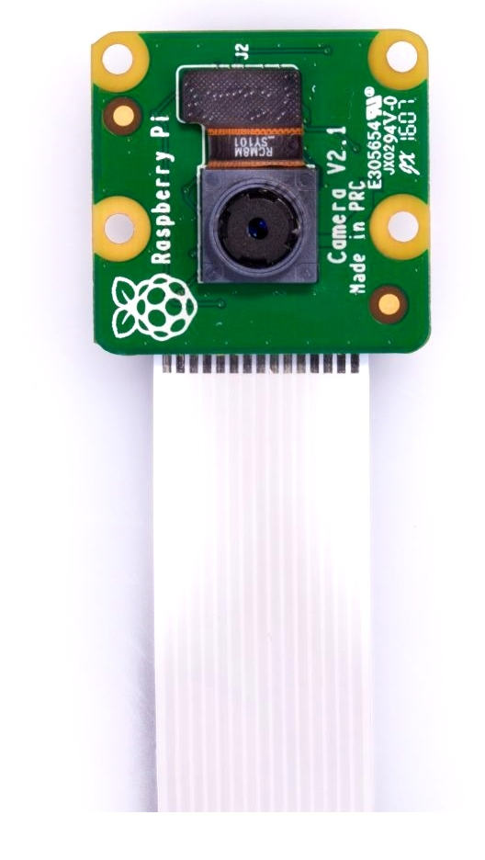
PI CAMERA:

Slide 31
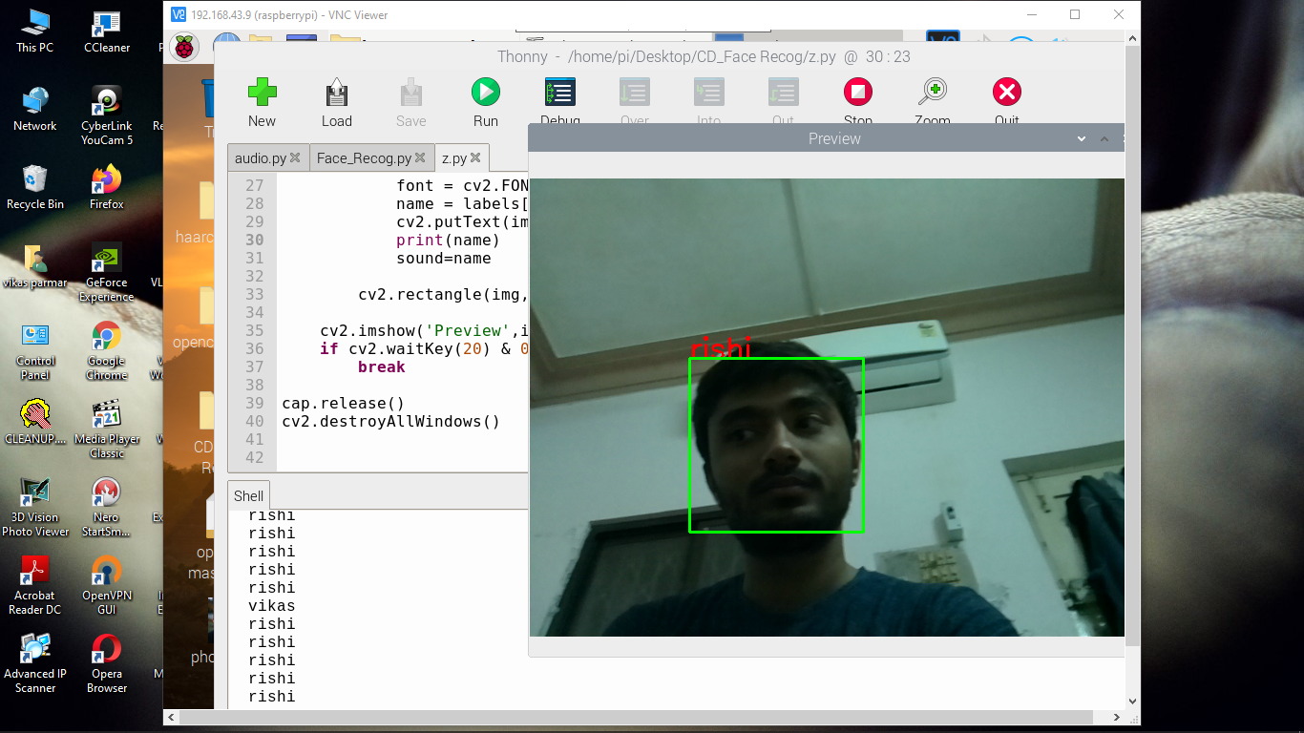
Face Detection And Face Recognition:
Face Detection And Recognition:

Slide 32
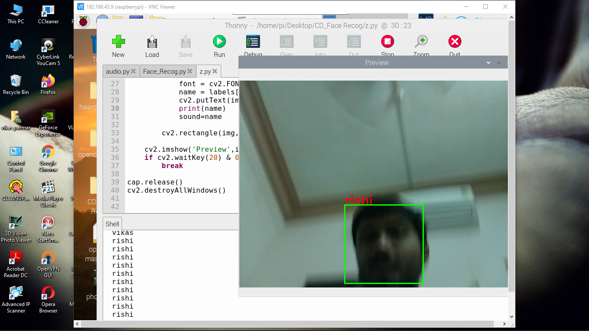

Slide 33
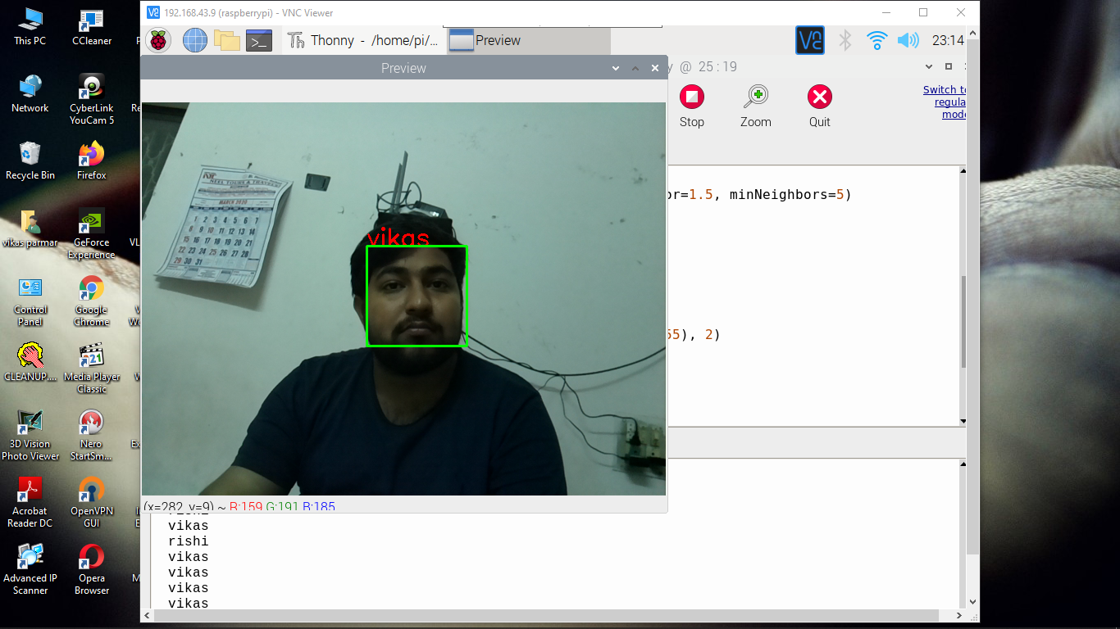

Slide 34
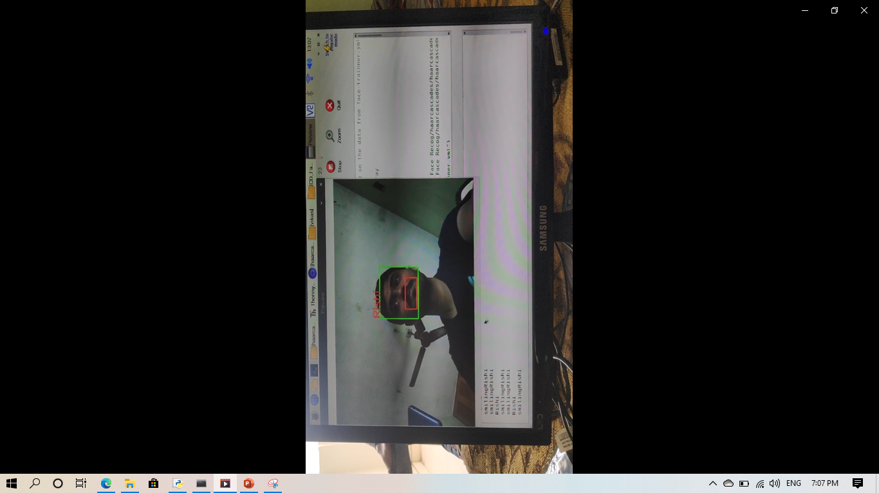

Slide 35
CONCLUSION

Slide 36
CONCLUSION
Hence, We are concluded that “Blind-Face” Assistance will be Helping system for a blind person in digital world. Now a day, Image Processing is very famous technology, which help for extracting information from image. Blind person’s life can be more flexible and relaxed with image processing acting as medium and blind person can identify person expression and get communication in easy way. They also avoid obstacles using this device. so that they can't get injured by this type of obstacles in a way. So using this app our motive is to help the blind person using device.

Slide 37
REFERENCES
K. M. Biradar, Varun Kesana, K. B. Rakhonde, Ankita Sahu, A. B. Gonde, S. Murala,, Local Gaussian Difference Extrema Pattern: A New Feature Extractor for Face Recognition, IEEE, 2017
Rajeev Ranjan, Ankan Bansal, Jingxiao Zheng, Hongyu Xu, Joshua Gleason, Boyu Lu, Anirudh Nanduri,Jun-Cheng Chen, Carlos D. Castillo, Rama Chellappa, IEEE-2015
Asif Anjum Akash, A. H. Akhand, N. Siddique, Robust Face Detection Using Hybrid Skin Color Matching under Different Illuminations IEEE / 2019
Huaizu Jiang, Erik Learned-Miller, Face Detection with the Faster R-CNN, IEEE/2017
M. Sivaram, V. Porkodi, Amin Salih Mohammed and V. Manikandan, Detection of accurate Facial detection using Hybrid Deep Convolutional Recurrent Neural Network, ICTACT-2019
Saransh Sharma, Samyak Jain, Khushboo, A Static Hand Gesture and Face Recognition System for Blind People, Springer(ICOSPIN)-2019
Maria Mahmood, Ahmad Jalal, Hawke A. Evans ,Facial Expression Recognition in Image Sequences Using 1D Transform and Gabor Wavelet Transform,IEEE-2018

Slide 38
Continue…
Maria Mahmood, Ahmad Jalal,Hawke A. Evans, Real Time Facial Expression Recognition Based On Deep Convolutional Spatial Neural Networks, IEEE-2018
Ashutosh Vaish, Sagar Gupta, Neeru Rathee, Enhancing Emotion Detection Using Metric Learning Approach,IEEE-2018
Sadaf A. H. Shaikh, Dipti jadhav, Human Face Detection and Facial Expression Identiﬁcation,IEEE-2018
Dr. Naveen Kumar Gondhi, Er. Navleen Kour ,A Comparative Analysis on various Face Recognition Techniques , IEEE-2017
Aditya Dixit, VR Satput, SIFRS: Spoof Invariant Facial Recognition System,IEEE-2018
Vinodpuri Rampuri Gosavi, Dr. G. S. Sable,Dr. Anil K . Deshmane , Evaluation of Feature Extraction Techniques using Neural Network as a Classifier : A Comparative Review for face Recognition,IJSRST-2018

Slide 39
Continue…
Omoyiola, Bayo Olushola, Overview of Biometric and Facial Recognition Techniques, IOSR-JCE 2018
Rajesh Kumar, Gargi Kalia,Mobile CMOS Image Sensor Test System through Image Processing Technique,IJSTSRD-2019
Huaizu Jiang, Erik Learned-Miller, Face Detection with the Faster R-CNN, IEEE 12th International Conference on Automatic Face & Gesture Recognition, 2017
www.reserchare.in

Slide 40
THANK YOu…

